Slide 1


SNAP PARTICIPATION & MACHINE LEARNING
GROUP 2
Shareen, Le, Richard and Mauricio

Slide 2
Slide 10
The scope is SNAP participation surveys in 2012 and 2013
The source is the U.S. Department of Agriculture via FoodAPS National Household Food Acquisition and Purchase Survey (link)
This project resulted in
4826 records retrieved
SQL database and csv file
Unique visualizations
Executive Summary
10

Slide 3
Background
What is the SNAP Program?
Simplified Nutritional Assistance Program
SNAP provides food benefits to low-income families to supplement their grocery budget so they can afford the nutritious food essential to health and well-being
Today, 41.2 million people, or 22.2 million households use the SNAP program
Enrollment
SNAP enrollment spiked after the 2008 recession and spiked again in 2020, with 13% of all households in the US in the program
Eligibility requirements vary by state but include:
Gross monthly income — must be 130% below the poverty line
Net income, or household income
Assets

Slide 4
Our Project
We are looking at demographic information to determine if a household is on SNAP or not.
Using this model, we could:
Predict which households are at risk of needing SNAP
Predict how much of the population is on SNAP
Why?
Individuals who regularly receive income support are more likely to suffer long-term economic disadvantages
It is a time-consuming process for case workers to determine if households are eligible for the program
If we can identify individuals or households who are most likely be long-term recipients, we would be more able to understand their needs and enact policy that would benefit them

Slide 5
Order of Operations & Outputs
Retrieve SNAP data from U.S. Department of Agriculture website
Data Cleaning
Machine Learning Modeling
Exploratory Data Analysis
SQL database
Histograms
Correlation matrix
Correlation heatmap
Boxplot
Pair plot
Line graph
Gantt charts
Logistic Regression
Random Forest
Neural network
.CSV file

Slide 6
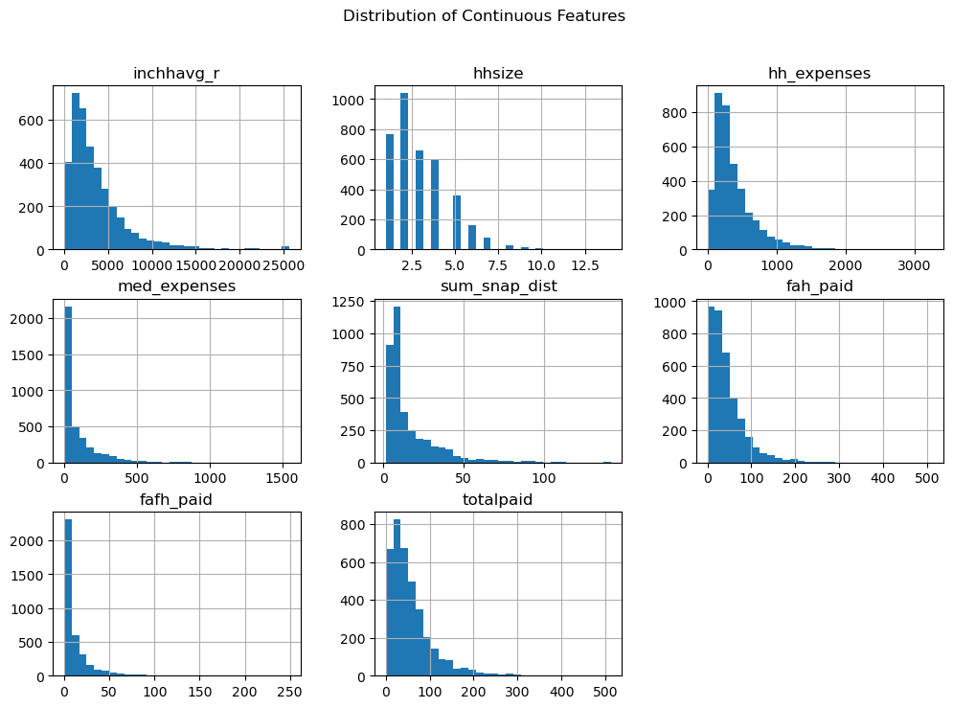
HISTOGRAMS OF CONTINUOUS VARIABLES
Income: Right-skewed, most households in lower income brackets.
Housing Costs: Broad range; spikes at higher costs.
Medical Expenses: Predominantly low, with some high outliers.
Insight: Highlights financial strain indicators and potential SNAP participation.

Slide 7
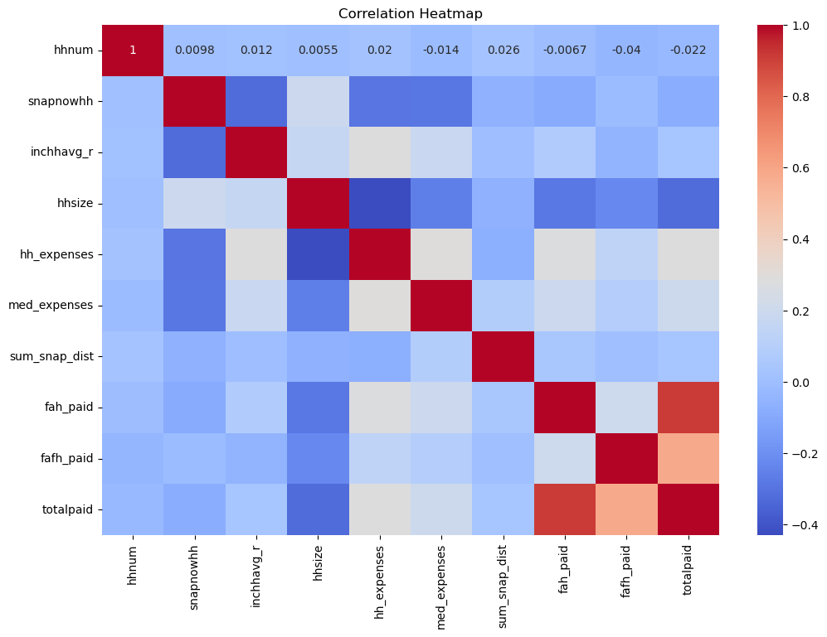
CORRELATION HEATMAP
Income & SNAP: Moderate negative correlation; lower income increases SNAP likelihood.
Housing Costs & SNAP: Positive correlation; higher costs increase SNAP likelihood.
Household Size & SNAP: Positive correlation; larger households more likely to participate.
Insight: Identifies key predictors and variable interactions for SNAP participation.

Slide 8
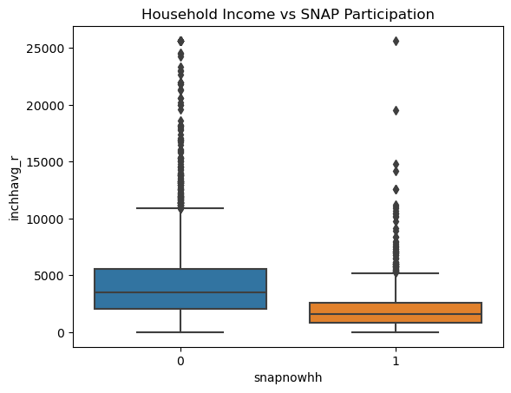
BOXPLOT: Household Income vs. SNAP Participation
SNAP Participants: Lower income, more compressed range.
Non-Participants: Wider income range, higher medians.
Insight: Highlights income differences between groups, supporting income as a key predictor for SNAP participation.

Slide 9
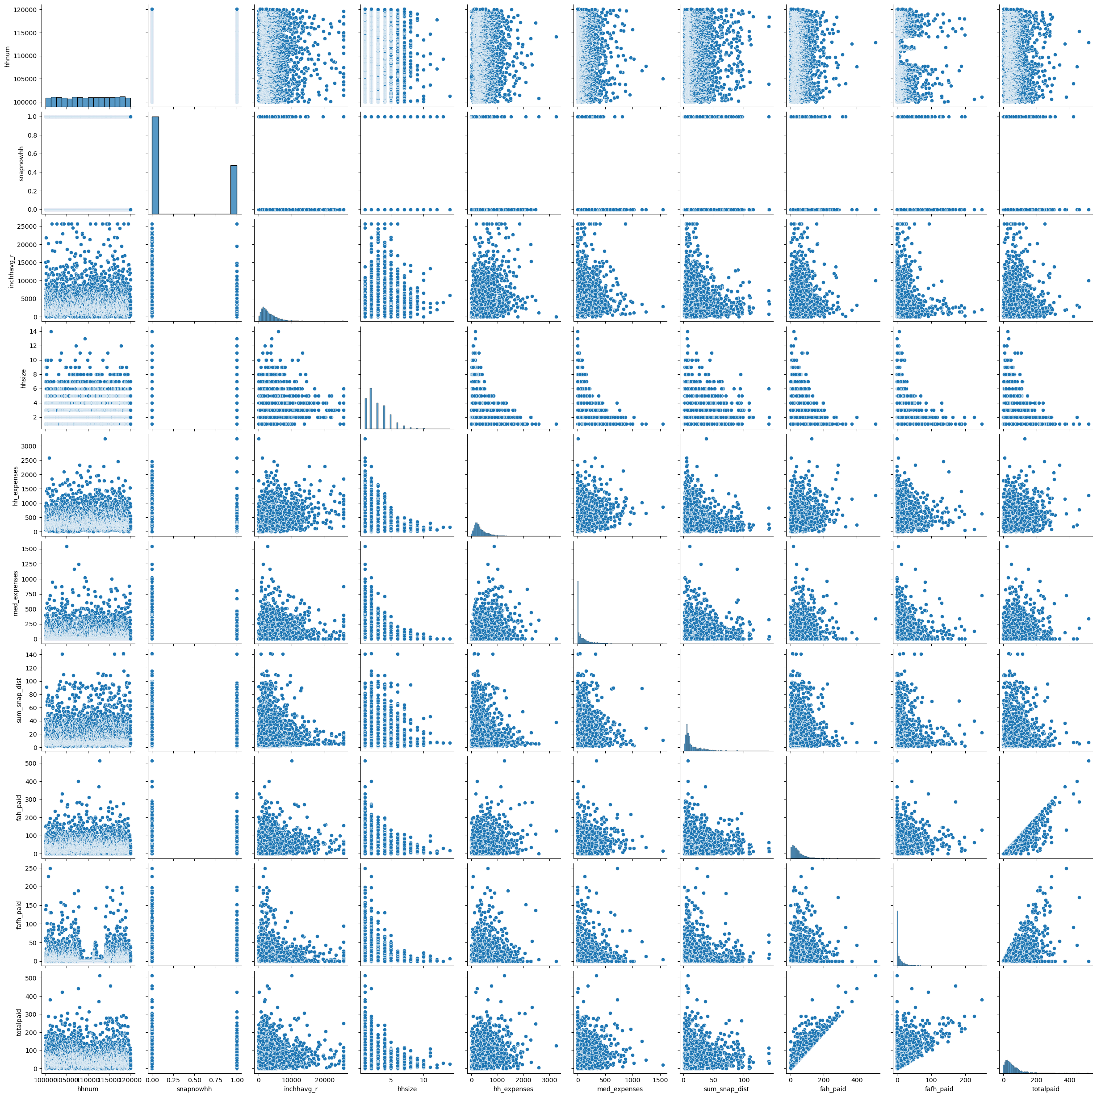
PAIR PLOT: Key Continuous Variables
Trends: Lower income and larger household sizes link to higher SNAP participation.
Distribution Patterns: Clear groupings between participants and non-participants.
Insight: Visualizes correlations and helps identify predictors for modeling.

Slide 10
MACHINE LEARNING MODELING
Logistic Regression
Random Forest Analysis
Neutral Network Testing

Slide 11
MACHINE LEARNING MODELING
Logistic Regression
Random Forest Analysis
Neutral Network Testing
Used the same Features described above in the EDA

Slide 12
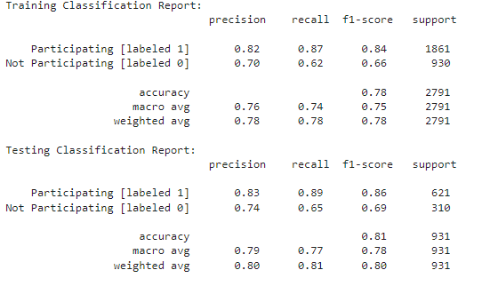
Logistic Regression
First Iteration
The model predicts with an average accuracy of 78%

Slide 13
Logistic Regression
First Iteration
The model predicts with an average accuracy of 78%
The model struggles to accurately predict "Not Participating" instances

Slide 14
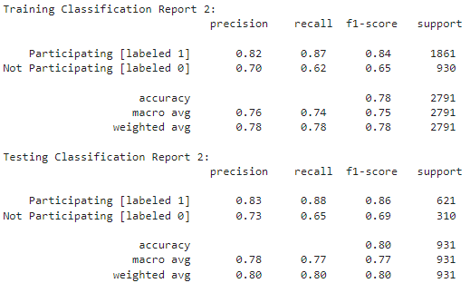
Logistic Regression
First Iteration
Second Iteration
(after removal of two features)
Still 78%
The model predicts with an average accuracy of 78%
The model struggles to accurately predict "Not Participating" instances

Slide 15
Logistic Regression
First Iteration
Second Iteration
(after removal of two features)
The model predicts with an average accuracy of 78%
The model struggles to accurately predict "Not Participating" instances
CONCLUSION: No improvement to model accuracy by removing features, namely fah_paid and fafh_paid

Slide 16
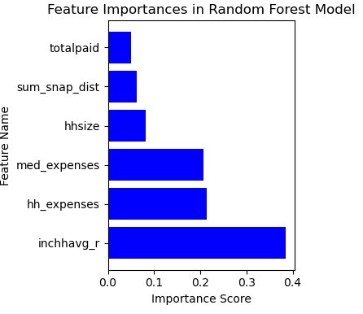
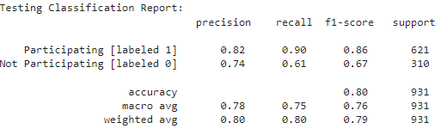
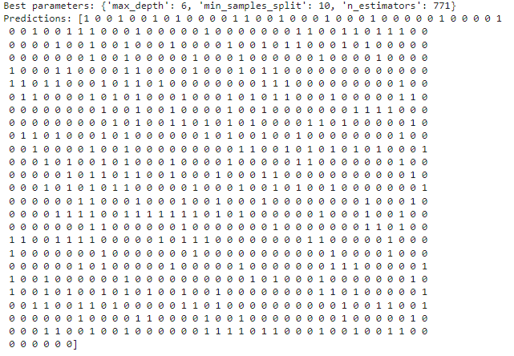
Random Forest
Classification Report
Feature Importance
Best parameters and predictions:

Slide 17
Random Forest
Classification Report
Feature Importance
Best parameters and predictions:
Household average (monthly) income [inchavg_r] has the highest Importance Score

Slide 18
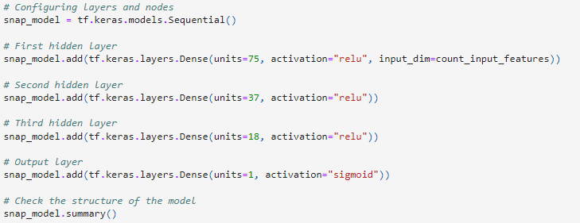
Neural Network
First Iteration w/ relu
0.782

Slide 19
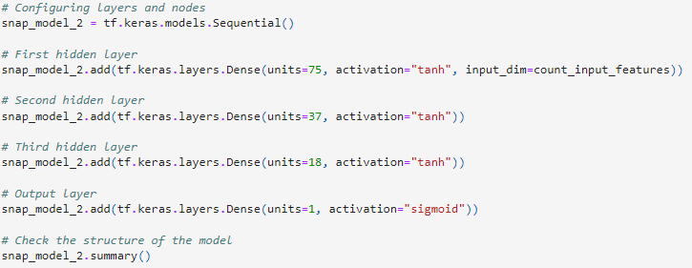
Neural Network
First Iteration w/ relu
Second Iteration with tanh
0.782
0.802

Slide 20
Neural Network
First Iteration w/ relu
Second Iteration with tanh
0.782
0.802
One tweak led to a 2.6% increase
CONCLUSION: Changing to activation function to tanh may be advantageous because tanh is centered around 0 [-1 to 1], whereas relu is less centered [0 to infinity]. This may be because our y feature is binary in nature (1 = yes, 0 = no).

Slide 21
Tableau for the SNAP Participation and Machine Learning Project
Bar and line charts to visualize Count of household, avg. of Snap distance and avg. of income vs household size
Scatter plot of the distribution of FAFH Paid and FAH Paid
Gantt charts to visualize Avg. Income vs. Expenses
TABLEAU

Slide 22
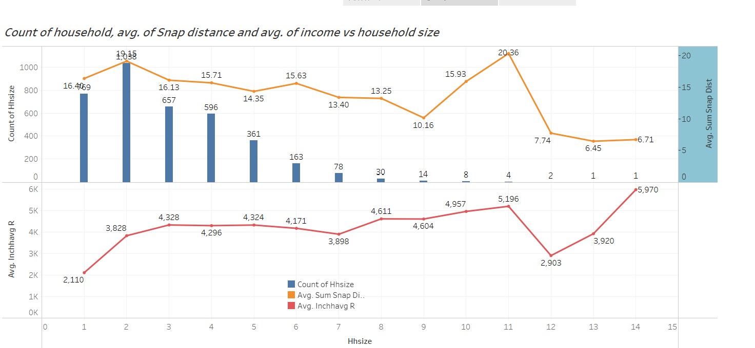
Bar and line charts to visualize Count of household, avg. of Snap distance and avg. of income vs household size

Slide 23
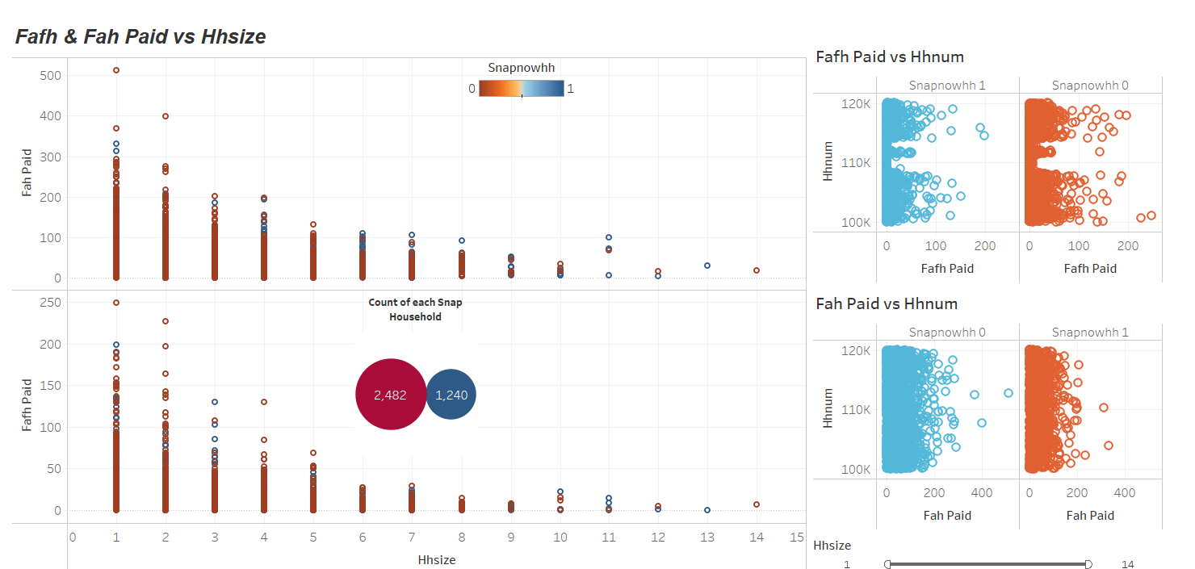
Scatter plot of the distribution of FAFH Paid and FAH Paid

Slide 24
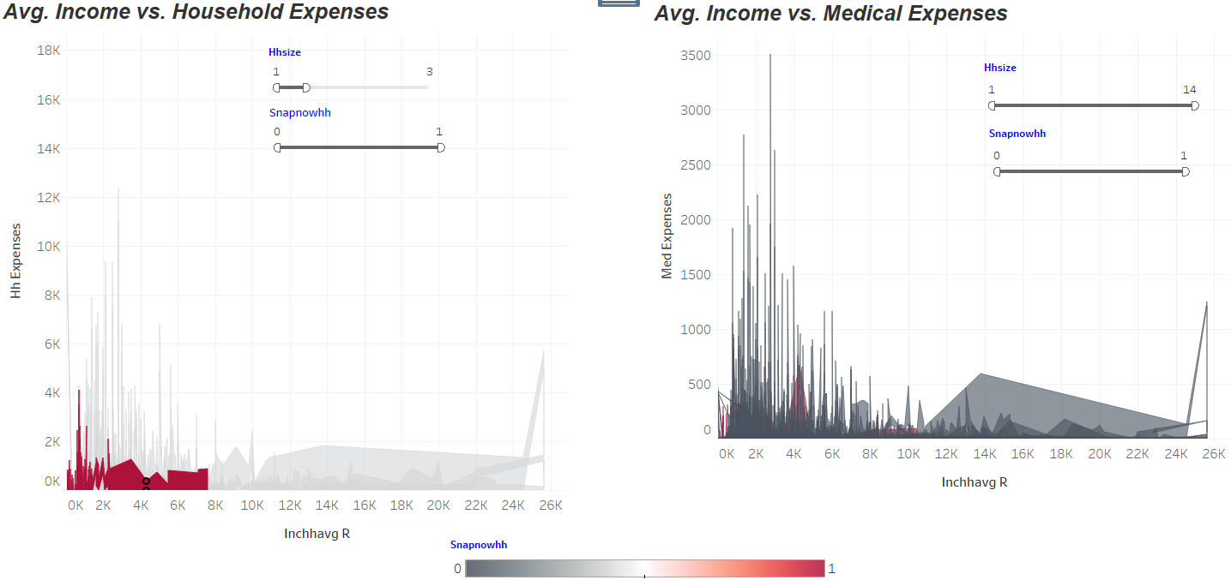
Gantt charts to visualize Avg. Income vs. Expenses
Notes:
Le

Slide 25
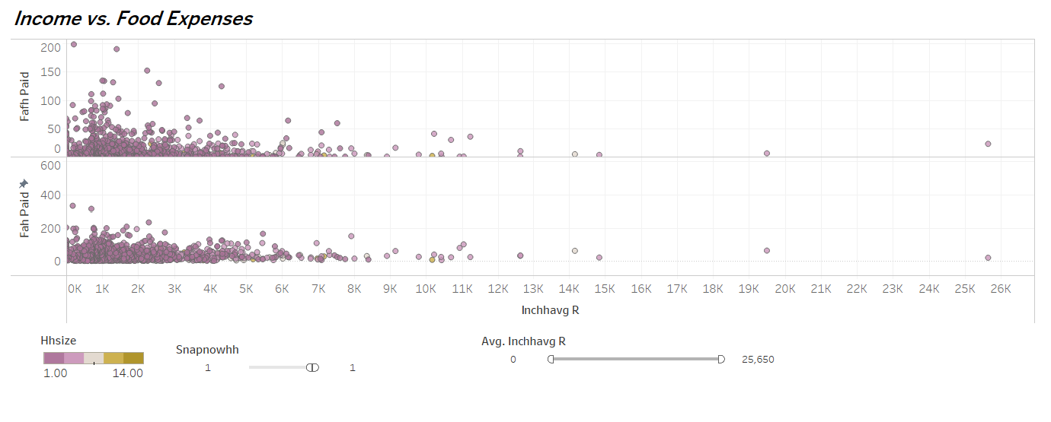
Gantt charts to visualize Avg. Income vs. Expenses

Slide 26
Next Steps
Our first model examined only 6 factors. Further consideration could be taken for other variables included in the dataset such as:
Childcare/support costs
Transportation access
Employment status
Evaluating different parameters for machine learning models
Evaluating additional sources of information available about SNAP or other similar programs within the United States
Adapting the model against bias

Slide 27
Questions
We are happy to take your questions about our project

